Slide 1

Movie recommendation system
Submitted to:
Prof. Chintan Bhatt
CSE 2020
By:
Kris Narola Vivek Lakhani Vatsal Chauhan
20BCP164 20BCP154 20BCP166

Slide 2

Agenda
Abstract
Introduction
Literature Survey
Related Work
Dataset Description
Proposed Work
Conclusion
References

Slide 3



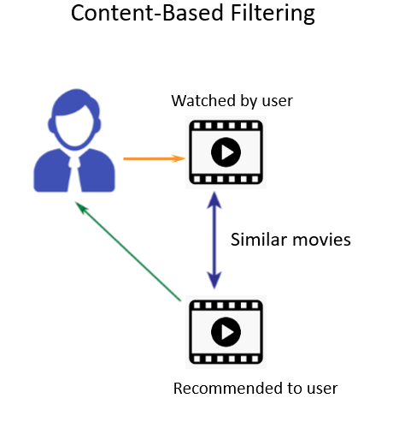
Abstract
In one of the many scenarios today, we are bound to choose one option from a movie dataset. While dealing with a large movie dataset this becomes a challenge so we need to choose a different approach for selecting option from a given movie dataset. One substitute for this that gives you suggested options is the recommendation system, depending on the searches you've previously made or the most popular searches right now. Movie recommendation systems usually predict what movies a user will like based on the attributes present in previously liked movies

Slide 4




Introduction
Movie recommendation system is a ML based approach for filtering the viewers films choices based upon the past searches and choices, contains mainly two things user and movies. To predict those movies that a corresponding user is most likely to want to watch. Encouraging the spectator to watch a movie based on recommendation rather than browsing through the vast amount of info as well as to minimize human labor. The profits owned by multinational companies using recommendation system are show below:
Netflix | 2/3rd of the movies watched are recommended
Amazon | 35% sales from recommendations

Slide 5





Literature survey
Traditional
system
Recommender system
Approaches
Modern systems
Efficiency
Website collects global ratings.
No personal recommendation system
Ex AOL Movies
Numerous System have been developed over the decade.
Different approach to make system.
Content Based
Collaborative Filtering
Hybrid
Rating from previous user to make recommendation
Related recommendation
Ex. Netflix

Slide 6


Related work
Personalization techniques:
Content-Based , Collaborative filtering, Hybrid
Approaches for collaborative filtering
User Based, Item Based
Different types of Similarity and Dissimilarity measures
Cosine Similarity, Euclidean Distance, City Block Distance,
Correlation(K-Movie Reco.)
Using Deep Learning Models
ex SVD++CF

Slide 7
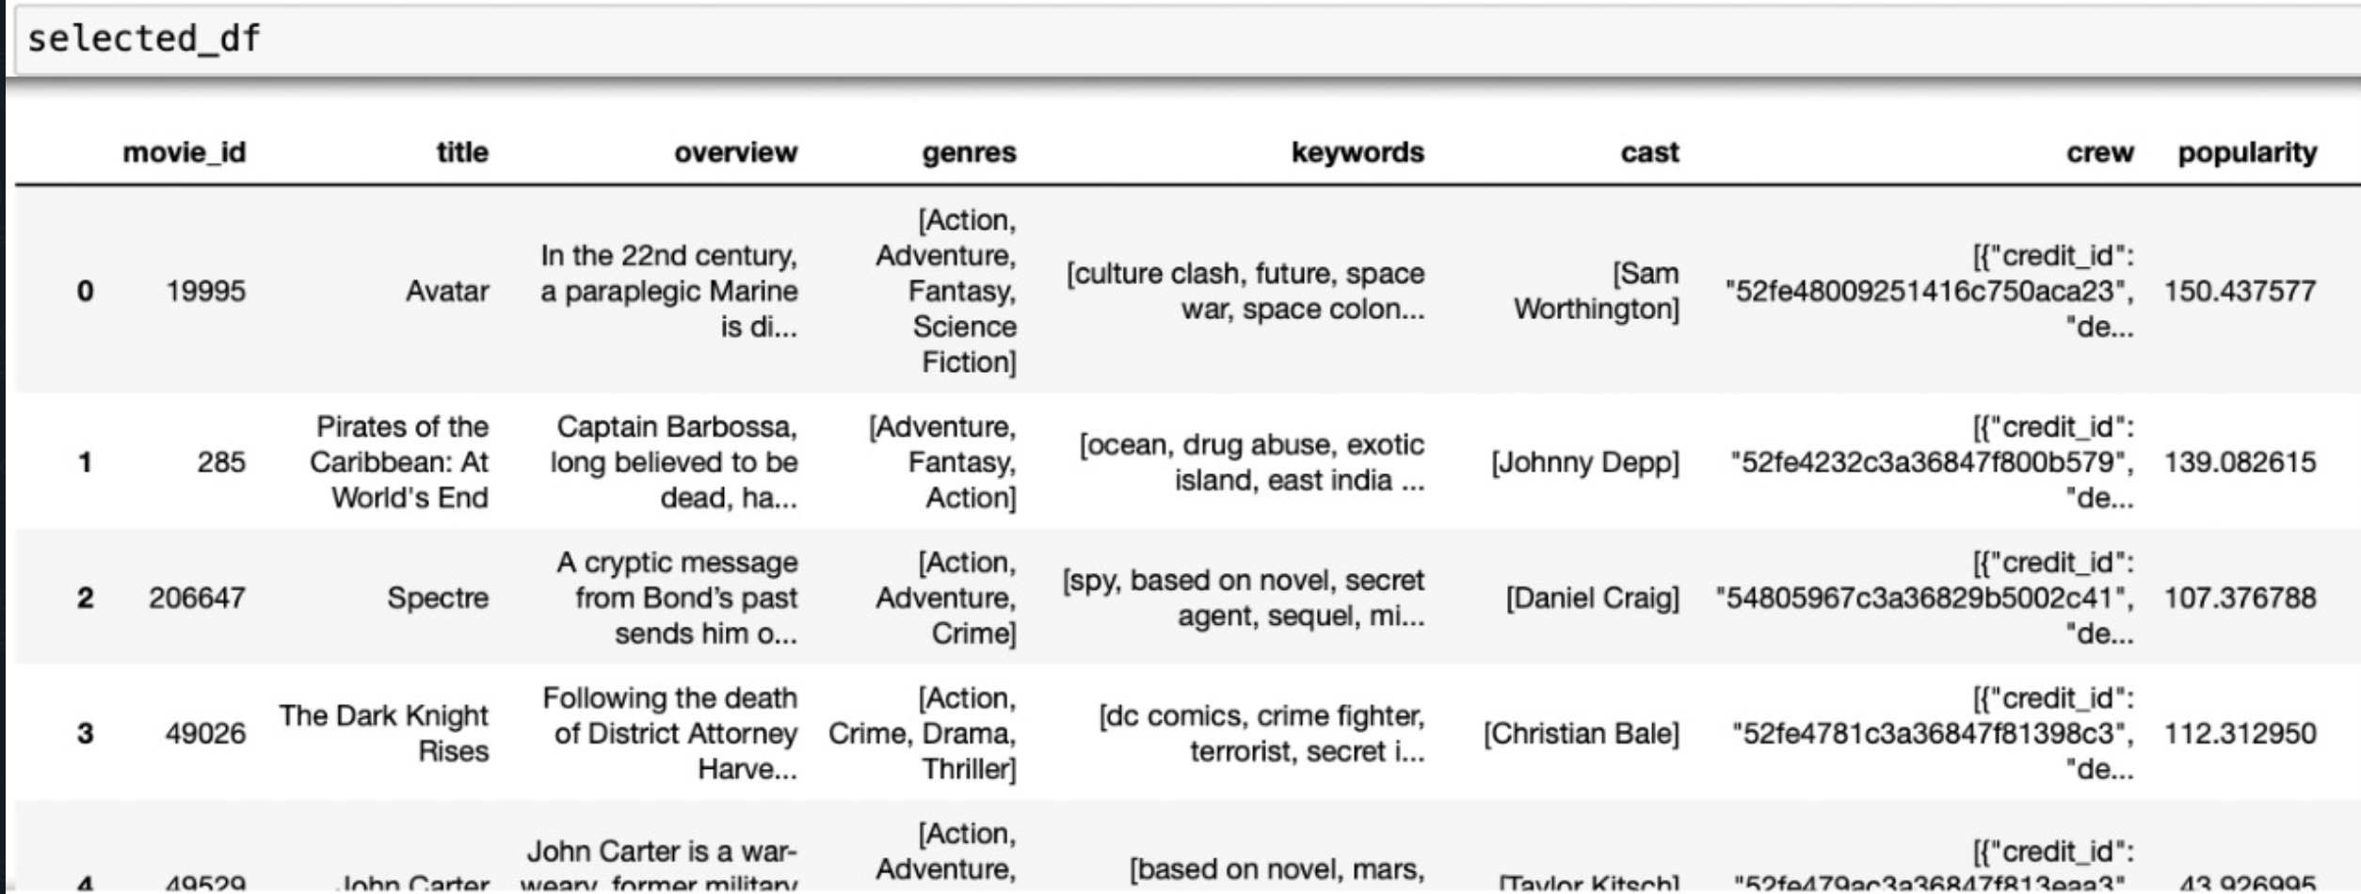
DataSet Description
In proposed model we use a pre filter before applying Remove Null Values , Feature Selection in Genre using AST(Abstract Syntax Tree) , K-means algorithm. The attributes used to calculate distance of each point from centroid are Movie_Id , title , overview , Genres, keywords , Actor , Director , Year , Rating , popularity. Here Different attributes have different weights.

Slide 8
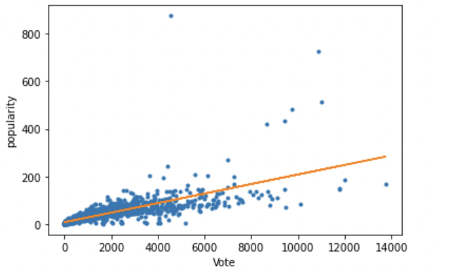
In our project we have found that the most appropriate movie recommendations that can be generated should be based on the Popularity and other is vote that movie got here from the dataset analysis we have found that as the number of vote’s increases the popularity should also increase respectively.

Slide 9
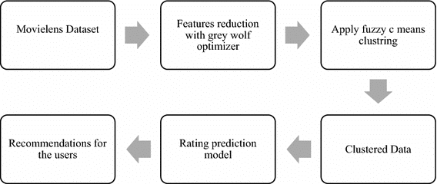
Proposed work

Slide 10
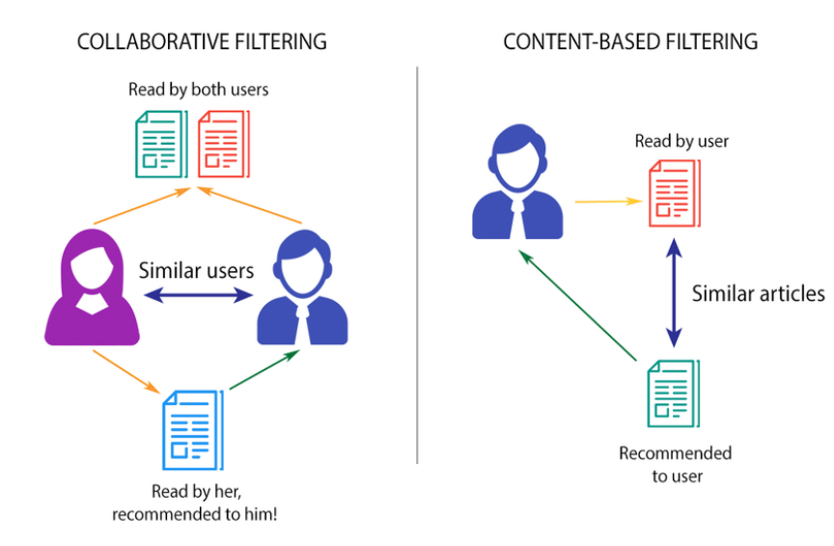
EXAMPLE

Slide 11

Conclusion
The recommendation system strategies are discussed in this project. The pros and cons of using various strategies are also explored, which aids in the development of an effective movie recommendation system.
accuracy similarity is attained by combining a variety of similarity measurements. This idea contributed to the system's overall efficiency improvement.
If we add more features to each film, the recommendation system's accuracy can be improved even more.
For the purpose of developing a system for recommending movies, hybrid filtering is primarily employed since it provides an effective suggestion system for the user.
There are a variety of methods that can be utilized to create a movie recommendation system, so the key is to pick a model that offers the user improved efficiency and accurate recommendations based on what viewers want.

Slide 12
references
https://pdfs.semanticscholar.org/c9f9/6d22422953625f1f8d9dbee221cba38e6c08.pdf
https://www.google.com/search?sxsrf=ALeKk00P037U5bp3y51QqWE-wCkvkCDUKw:1588619431266&source=univ&tbm=isch&q=content+based+filtering+diagrams&sa=X&ved=2ahUKEwi33YjH9JrpAhWFXSsKHR56DOAQsAR6BAgKEAE&biw=1366&bih=625
• https://www.imdb.com/list/ls063596142/
https://www.google.com/url?sa=i&url=https%3A%2F%2Fwww.researchgate.net%2Ffigure%2FContent-based-filtering-vs-Collaborative-filtering-Source_fig5_323726564&psig=AOvVaw1kmgiLjehG_mh15Rhio-7X&ust=1665567137668000&source=images&cd=vfe&ved=0CAwQjRxqFwoTCLjipqDv1_oCFQAAAAAdAAAAABAD
https://www.google.com/search?q=pip+python&oq=pip&aqs=chrome.2.69i57j0l6j69i60.3726j0j7&sourceid=chrome&ie=UTF-8
https://www.google.com/search?q=sublime+text+python&oq=sublime+&aqs=chrome.2.69i57j35i39l2j0j69i60l4.4504j0j7&sourceid=chrome&ie=UTF-8

Slide 13
THANK you

